Slide 1
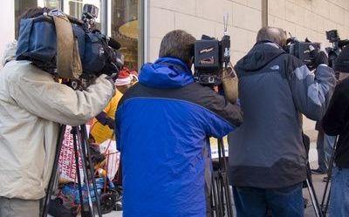
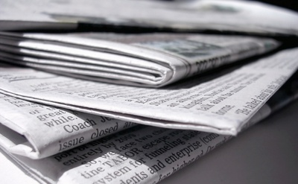
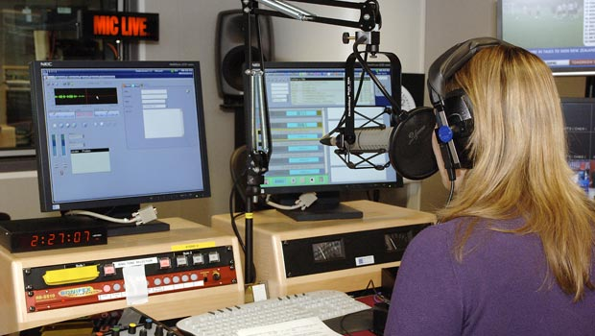
Generating Positive Media Coverage of College Alcohol Prevention:
Strategies and Steps
Tom Workman, Ph.D.
Principal Communication Researcher and Evaluator
American Institutes for Research, Washington, D.C.
Nebraska Collegiate Consortium Training June 22, 2012

Slide 2
10 Golden Rules of News Media Coverage for Prevention Efforts

Slide 3
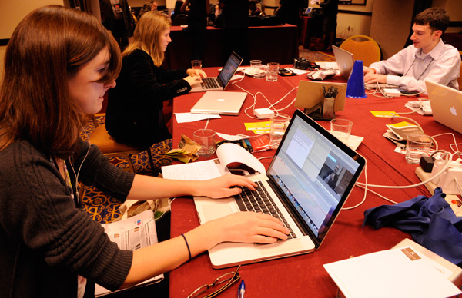
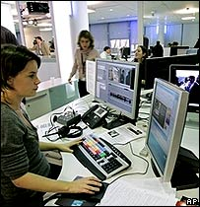
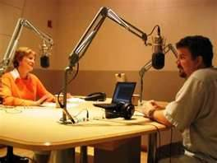
Understanding the News Media

Slide 4
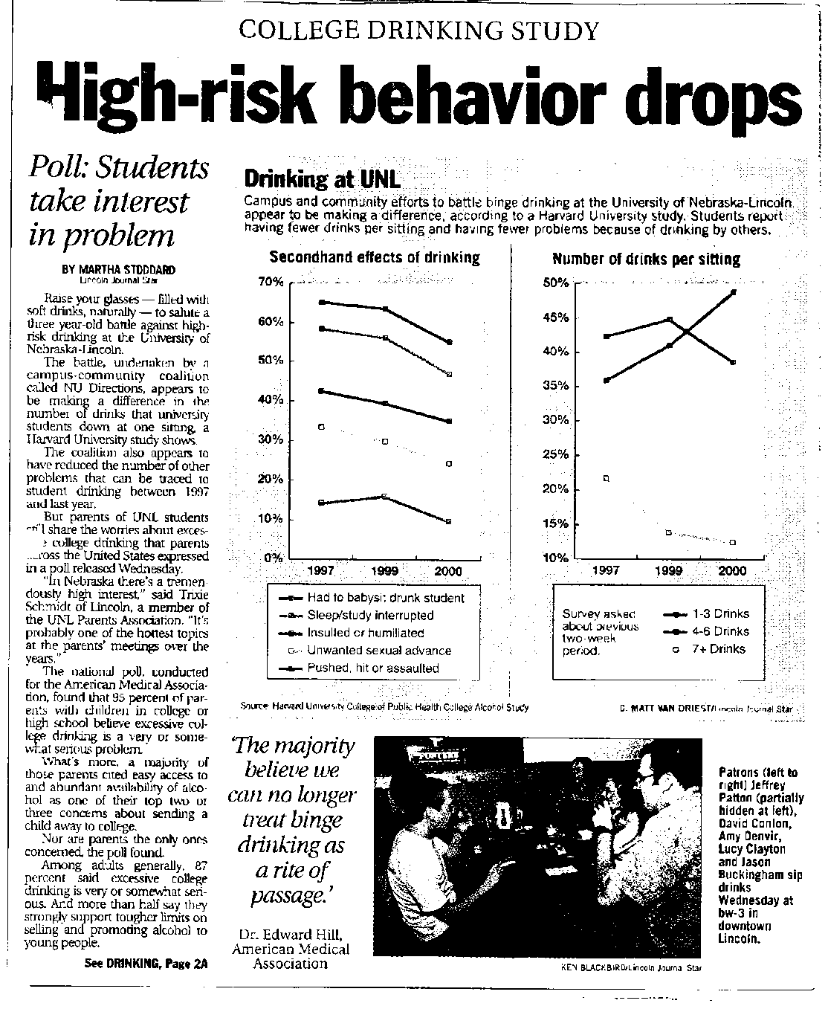
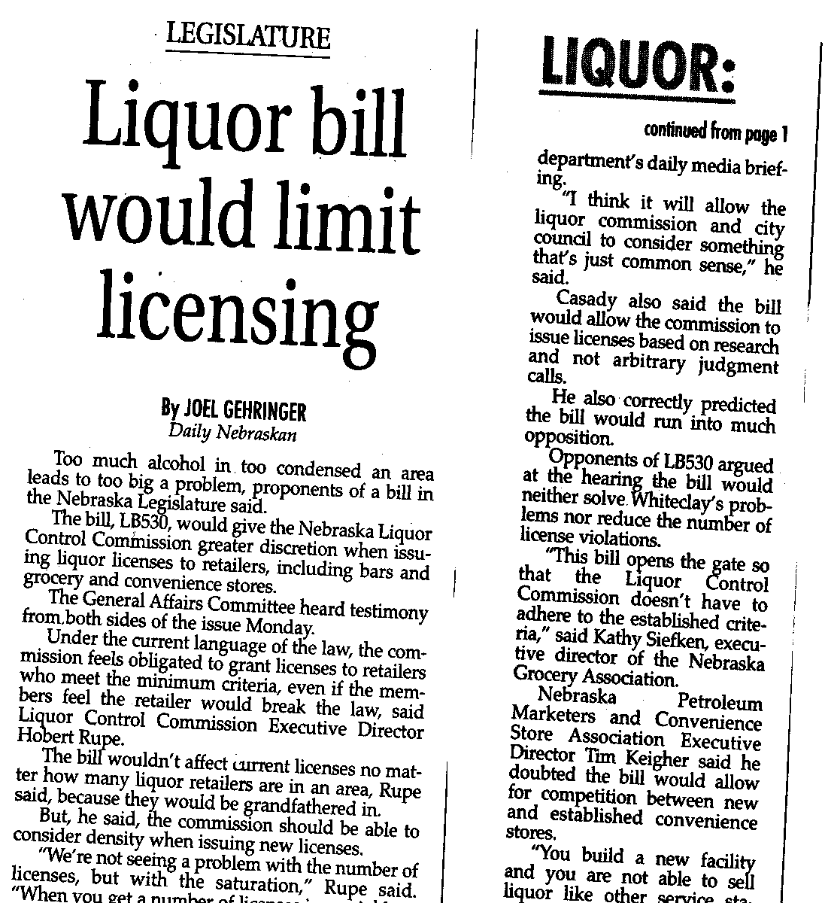
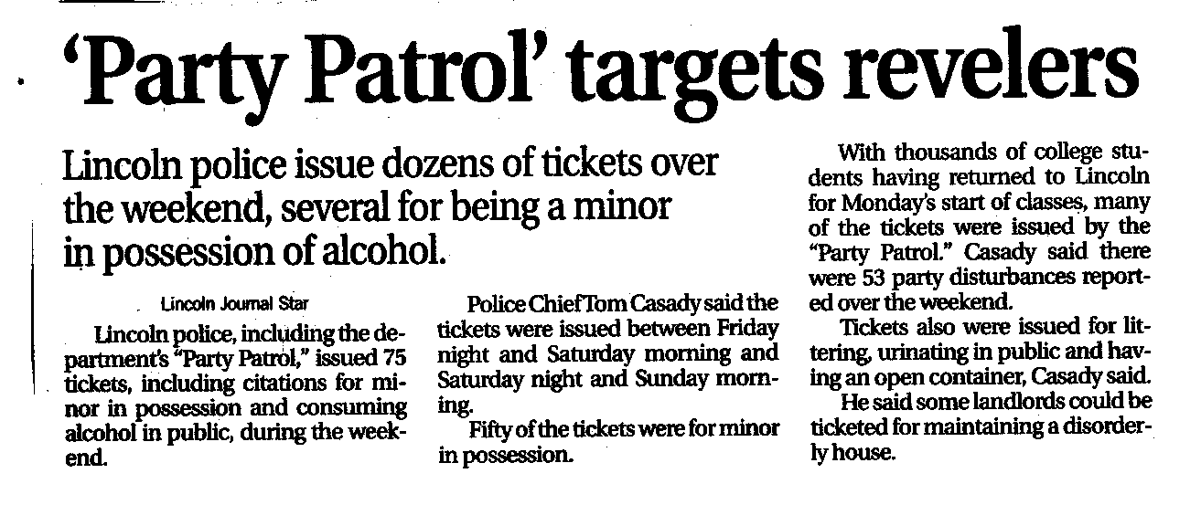
NEWS

Slide 5
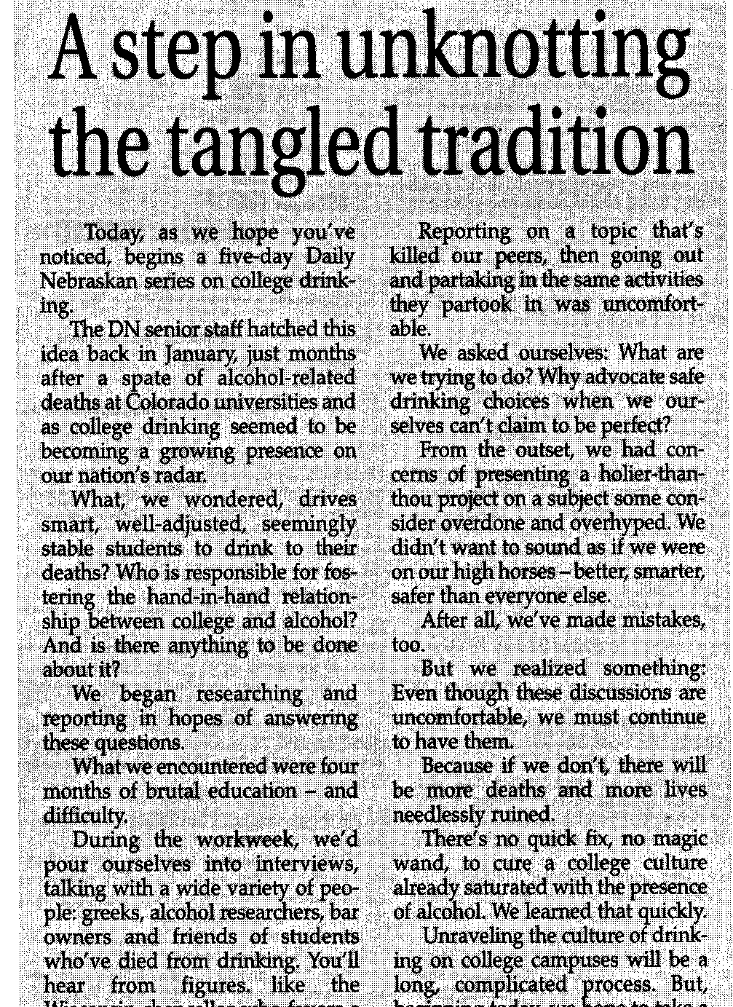
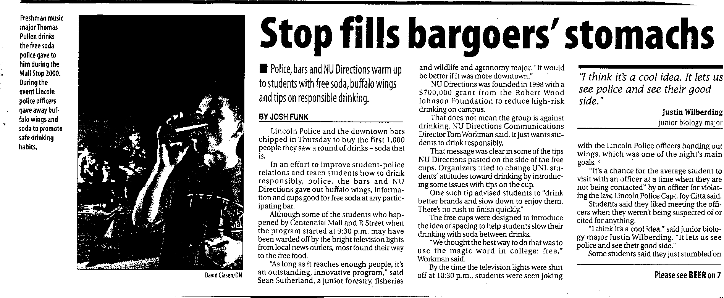
FEATURE

Slide 6
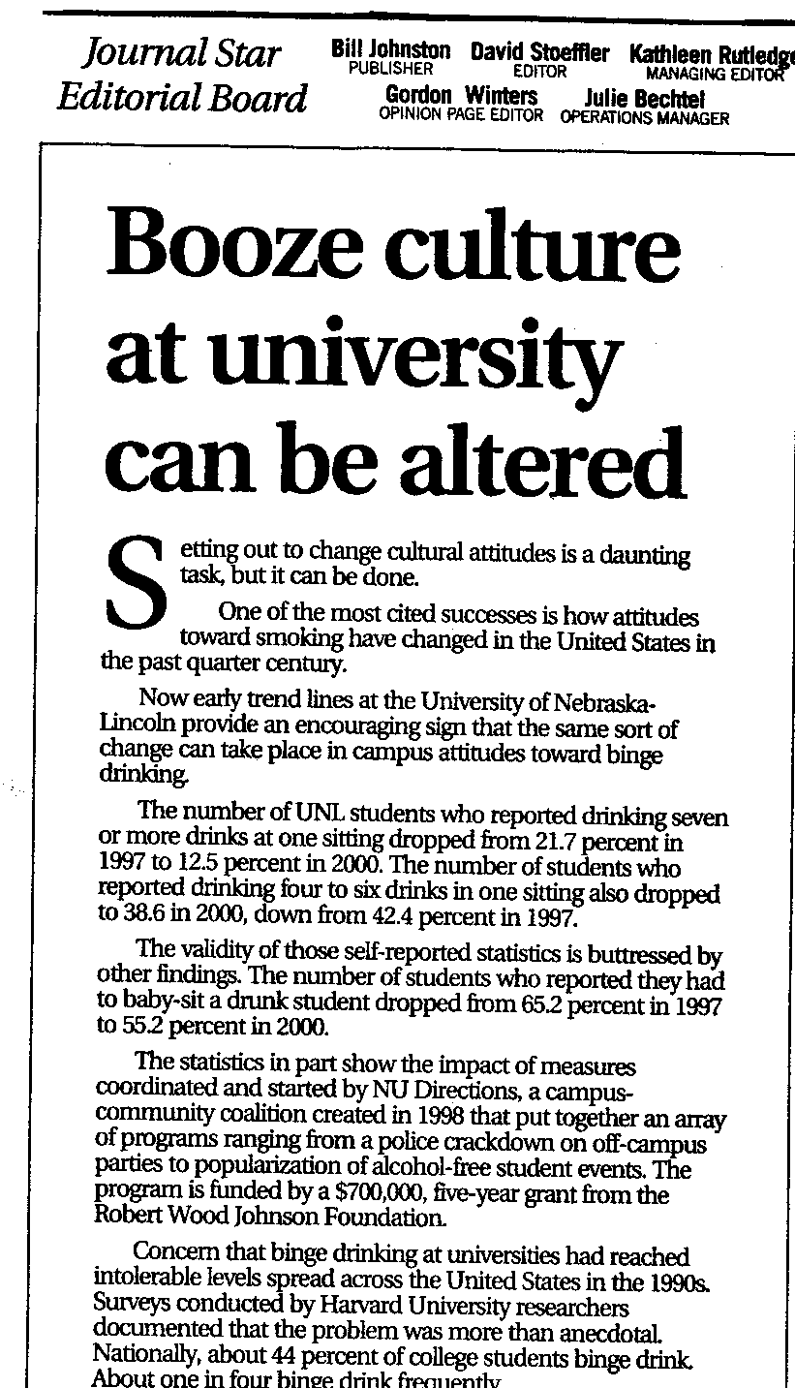
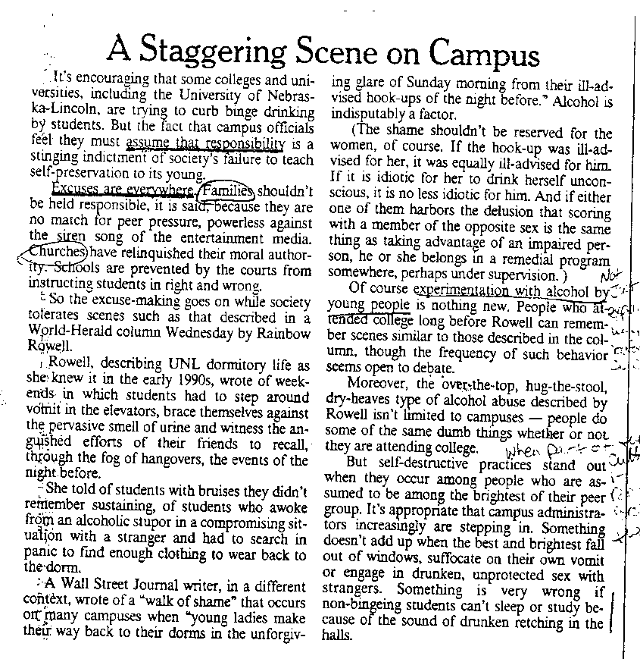
EDITORIAL

Slide 7
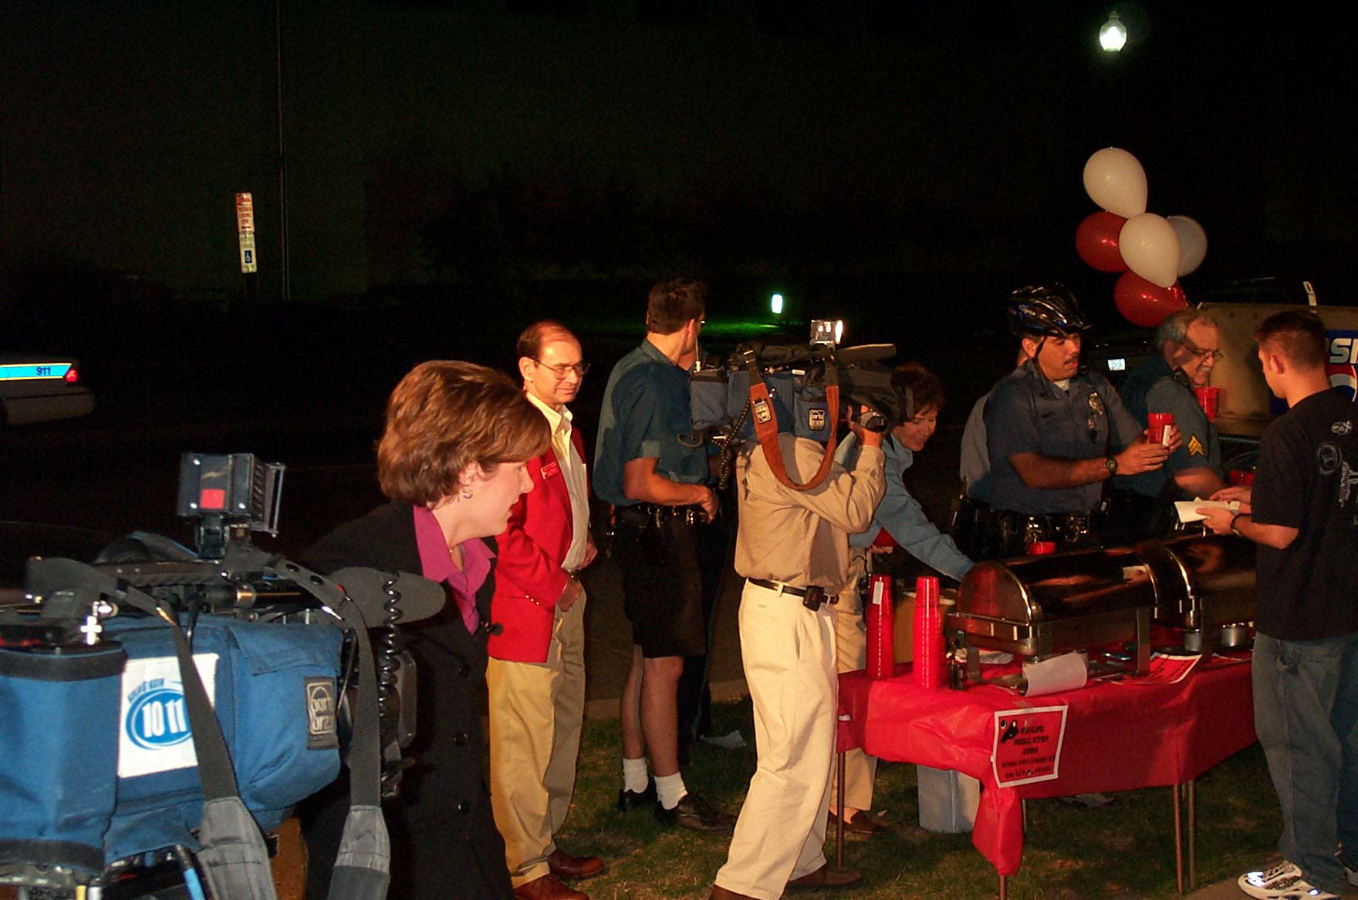
Your Media Audit

Slide 8
Precontemplation
Contemplation
Planning
Change
Maintenance
Fidelity story: We want to address potential threats to what we have
Alarm story:
We have a problem
Results story: Change is occurring, benefits seen
Involvement story: We’re planning change
Action story: Look at what we’re doing

Slide 9
Your Media Plan
Where is our community regarding high-risk college alcohol consumption?
What kind of media coverage is needed RIGHT NOW to move the community to the next stage of the process?
Is there a specific group in the community most in need of progression through media coverage?
What opportunities are available to us/can we create that can serve as the strategic media story to move this aspect for the community?

Slide 10
CENTRAL MESSAGE
One sentence, one main thought
MAKE IT ACTIVE!
Elaborate 1: what is the effect?
Elaborate 2: what is the reason this is happening?
Elaborate 3: what are the costs of addressing this?
Elaborate 4: what are the benefits of action?

Slide 11
We will start breaking up wild parties.
Elaborate 1: Wild parties are causing issues for local residents and hurting quality of life
Elaborate 2: Wild parties need special detail so that hosts and goers know when a community standard is violated.
Elaborate 3: No one wants to end parties but to stop wild parties from causing harm. Our focus is on the wild out of control party, not any party.
Elaborate 4: Having a party patrol will resolve issues immediately for residents and send an important message to hosts.

Slide 12
Let’s Make Some Messages
Using the Message Box process, chart out a message for one of the stories in your media plan.

Slide 13
Pitching the Story
Pitch the relevance.
Pitch the timeliness.
Pitch a set of willing contacts.
Pitch the visual aspect.
Send the details.
Set up the opportunity.

Slide 14
Preparing the Press Kit
FOOL-PROOF reporting aid:
Here’s the correct story
Here are the people who can tell you more
Here is all the background
Here are any relevant facts and figures
Here are images you can use

Slide 15
Conducting Interviews
Give spokespersons time and materials to prepare.
Spend a few minutes building rapport with the reporter before starting.
Ask the reporter about their angle, and plan to interview accordingly with innoculation if needed.
All questions lead back to your message.

Slide 16
Final Thoughts & Questions

